Slide 1
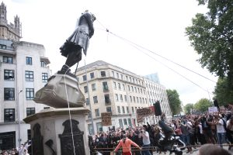
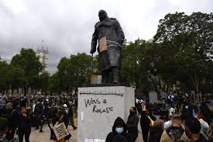
Toppling History
By Bridget Fish
An analysis of the political rhetoric around contested statues in the UK and the legal implications.
Notes:
Summer of 2020: The murder of George Floyd / Global BLM protests
structural racism and inequality
Statues of historical figures targeted as symbols of inequality
Most notable in the UK:
London: statue of Winston Churchill in Parliament Square.
Bristol, the statue of Edward Colston (a philanthropist and slave trader) was toppled and thrown into Bristol Harbour by protesters.
This last event is thought to have been the catalyst for the removal or renaming of 69 statues and place names across the UK, over the next six months.

Slide 2
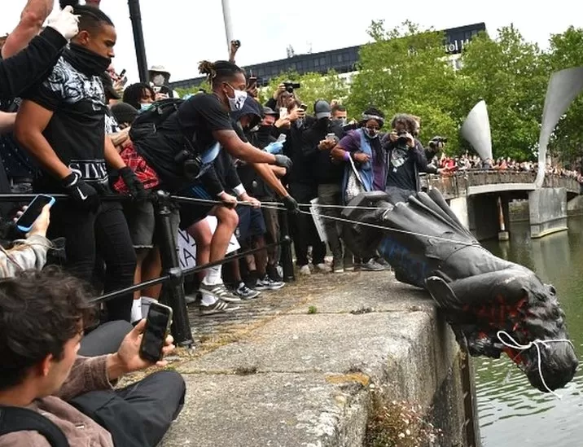
New Legislation
Town and Country Planning Order (2021) Planning permission required to remove a statue from a public place.
Police, Crime, Sentencing and Courts Act (2022) Increased the maximum penalty for criminal damage to a memorial from three months to ten years imprisonment.
Notes:
The Conservative Government’s response – new legislation to protect statues:
they should be ‘retained and explained’ rather than removed,
to protect history from being ‘censored’ or ‘erased’.
Legal protection for statues was introduced in two ways.
Town and Country Planning Order (2021) – makes it v difficult to remove statues and to contest them through official channels
Police, Crime, Sentencing and Courts Act (2022)
Critics like the Runnymede argue …
These further criminalise anti-racist protest, particularly for racial minorities
Statues are not complete apolitical versions of history. Who’s version of history is being censored and who’s voices are being silenced?
The harsher sentences will address the distress caused by damage to statues – but distress to whom? What about the distress the statues themselves cause?
Rupa Haq, Labour MP for Ealing Central and Acton, said in Parlimentary debate on Preserving Heritage and Statues in the City: Minimum sentence for rape in the UK is 5 year … but someone can get 10 years for pulling down a statue. “That implies that dead white men, mostly in bronze and stone are valued more than living, breathing women.”

Slide 3
Question: Does the political rhetoric around contested statues allow for heterogeneity, equality and social justice? Methodology: Critical Discourse Analysis.
Discourse:
Shapes and presents competing perspectives of the world.
Constructs topics, as much as it describes.
Can be seen as a social action, it has material consequences that matter.
Why CDA?
Critical Discourse Analysis (Foucault, Fairclough, Van Dijk and Wodak)
Looks closely power: how is reproduced, legitimated and exercised.
Power mostly remains invisible but texts are often sites of struggle which show traces of differing discourses and ideologies contending and struggling for discourse
Hegemony – dominant ideas become naturalised “common sense”.
Why political rhetoric not the legislation ?
Notes:
Critical discourse analysis (CDA), framed by the theories of Foucault, Fairclough, Van Dijk and Ruth Wodak, to analyse the Government’s response to ask:
Does the political discourse around contested statues allow for heterogeneity, equality and social justice?
Why analyse the political rhetoric not the legislation and why CDA?
Discourse is social action – has material consequences: new legislation
CDA is good methodology to explore how power relations are created and sustained – power often invisible but can be seen in texts, which are often sites of struggle.
Hegemony - The concept was popularised by the Italian Marxist Antonio Gramsci in the early 20th Century.
Dominant ideas become so naturalised that they are no longer thought of as ideological but rather as ‘common sense’. This creates social unity in favour of the dominant group. Rather than power being exerted through coercion, it is exerted through consent.

Slide 4
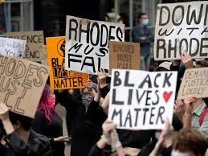
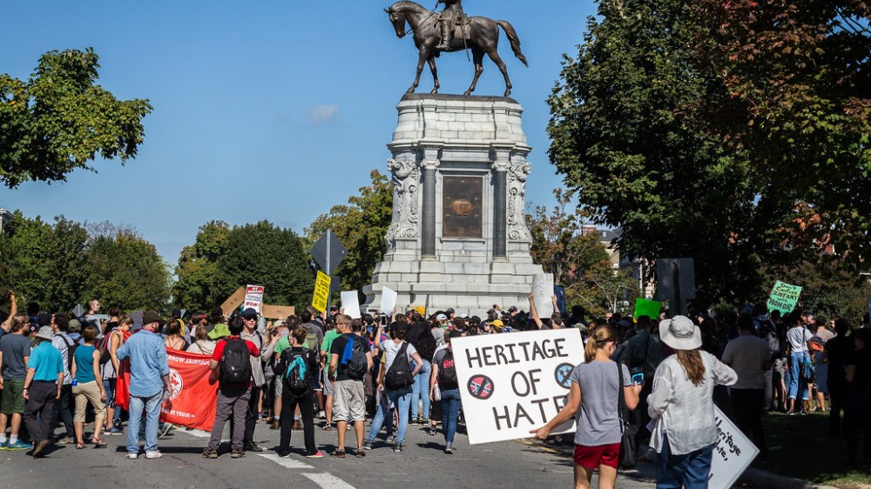
“Let’s fight racism, but leave our heritage broadly in peace” Boris Johnson, 2020.
“A tool for political resistance against marginalisation, discrimination and exclusion”
Sybill Frank & Mirjana Ristic (2020)
Notes:
Literature – important to look at Heritage.
The Government – dislocate ideas of heritage from structural racism and inequality
Activists and protesters – Statues centre of recent major protests about racism and inequality globally – Black Lives Matter in summer 2020.
Urban ‘Fallism’ movement: 2015 with the Rhodes must Fall campaign South Africa spread globally with monuments in the public space being targeted by protesters e.gs:
Confederate monuments in the US
Colonial monuments in South America
Lenin monuments in Eastern Europe
Has been a described as:
“As tool for political resistance against marginalisation, discrimination and exclusion”
So who and what heritage is for, is not a given and should be analysed.

Slide 5
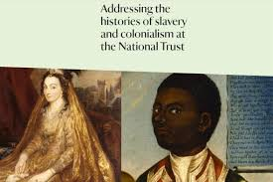

Heritage Discourse
‘The Heritage’
Stuart Hall (1999)
‘Authorised Heritage Discourse’
Laurajane Smith (2006)
“elite, class-based and white vision of heritage”.
Privileges static material heritage over the intangible
Draws a boundary between past and present
Heritage has to be saved for future generations, to educate
Heritage creates community identity but based on the nation and within that, the elite social class
Notes:
Academics in the late 1990s / early 2000 argued that there was a dominant discourse around Heritage which an “elite, class-based and white vision of heritage”.
Laurajane Smith calls Authorised Heritage Discourse or Stuart Hall calls ‘The Discourse’.
makes it difficult to use the past to challenge and rewrite cultural and social meaning in the present.
Heritage industry – last 30 years has shifted away, most notably with decolonisation and looking at the History of Empire.
Links to slavery, colonialism being investigated - museums and heritage organisations such as the National Trust.
But has the government moved away form this discourse? There has been a huge backlash recently to change the way heritage is understood, particularly around the issue of History of Empire.
Keen to maintain a nostalgic view of the History of Empire, the Gov have energised a unprecedented ‘culture war’.

Slide 6
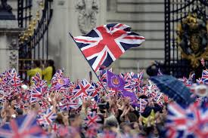
Culture Wars
“Britain is under attack – not in a physical sense, but in a philosophical, ideological and historical sense. Our heritage is under direct assault….”
Gareth Bacon (2021) Conservative MP for Orpington
‘Anti-woke’ Discourse:
Normalises fascist right-wing ideas
Reproduces structural racism
Distracts from social justice issues
Moral panic
Deviance
The tolerant framed as intolerant.
Notes:
Recent academic literature on the ‘culture wars’ argues that they an elite-driven, top-down phenomenon.
‘anti-woke’ discourse which:
Normalises fascist right-wing ideas once thought to be morally abhorrent but gradually accepted as the ‘new common sense’ which in turn has started to influence public policy.
Reproduces rather than opposes structural racism
Distracts from social justice issues
It does this through various ways, for example,
creating a moral panic about perceived leftwing cultural hegemony
contestations against social justice causes are being framed as abnormal and deviant.
The tolerant are being framed as the intolerant.
Question: Is this anti-woke discourse also found in the political rhetoric on contested statues?

Slide 7
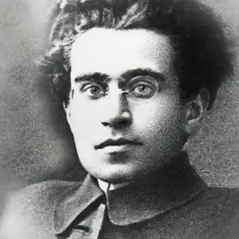
Hegemony
“War of Position”
Legitimisation
“Common sense”
Struggles for hegemony
‘The Heritage’ discourse maintains white power structures over who belongs and who doesn’t. (Stuart Hall 1999)
‘Anti-woke’ culture war - hegemonic strategy to normalise right-wing ideas and abnormalize social justice struggles. Cammaerts, B. (2022)
‘Anti-woke’ discourse - strategy to reinforce the hegemony of structural racism. Pilkinton (2022)
Antonio Gramsci – Italian Marxist
Early 20th Century
‘Anti-woke’ movement as “a rhetorical style designed around upholding hegemonic white power” Zavattaro and Bearfield (2022)
Notes:
A common theme running through the literature on Heritage and the Culture Wars is hegemony.
The concept was popularised by the Italian Marxist Antonio Gramsci in the early 20th Century.
Dominant ideas become so naturalised that they are no longer thought of as ideological but rather as ‘common sense’. This creates social unity in favour of the dominant group. Rather than power being exerted through coercion, it is exerted through consent.
Look at how key academics (e.g. Van Dijk and Norman Fairclough) have understood and used his key concepts:
Key concepts “common sense”, “war of position”
Hegemony is not manipulation but legitimisation
The struggles for hegemony (not the hegemony)

Slide 8
Analysis
Articles for Analysis
Public texts regarding contested statues
Conservative MPs
July 2020 to July 2021
Identify key themes and arguments
Look for association and variation
Examine characterisation and agency
Pay attention to emphasis and silences
Tonkiss (2004)
Newspaper article by Boris Johnson, PM (June 2020)
Newspaper article by Robert Jennick, Communities Secretary (Sept 2020)
Letter from Culture Secretary to DCMS Arm’s Length Bodies on Contested Heritage (Sept 2020)
Press Release: New legal protection for England’s heritage. Oliver Dowden and Robert Jenrick (Sept 2020)
Parlimentary Debates: Public statues, public Landmarks Review, Public Order TBC
Notes:
Why Conservative MPs
They instigated the new legislation
Recent study by the Policy Institute into the culture wars shows that 44% of the public believe that politicians invent or exaggerate culture wars as a political tactic”.
Dates are between Colston toppling and legislation coming into force.
How many articles: 6 – each 1 to 2 pages long
Analysis
Identifying key themes and arguments (analysing the different ways the themes emerge)
Looking for association and variation (what associations are established between different actors, groups or problems) (inconsistencies)
Examining characterisation and agency (what characteristics, problems or concerns are associated with different social actors or groups? From what standpoint does the speaker or author develop their account? How is agency attributed or obscured within the text?)
Paying attention to emphasis and silences
Tonkiss (2004)

Slide 9
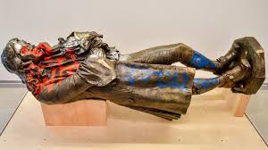
Final Thoughts
Explores the dominant discourses and power dynamics underlying new legislation
Limitations and further ideas:
CDA can show how but less so why. Motivation and Intent?
Scope: (time limitation):
Comparison of Conservative MPs rhetoric with:
Other political parties / The Media / Activists
Look in more detail at discourse around protest/art and public space.
Edward Colston statue on display at M Shed Museum, Bristol.
Notes:
Motivation – it can show what the effects are but can it really show why? Is it simply to maintain domination, distract from other things going on like failed policies, get more votes etc.
Intention? Can it show that they are intentionally creating and/or maintaining hegemony?
Are other political elites / the media / activists using the same discourse or something different and what are the implications of this? Counter-hegemony.
Can they show better ways to be inclusive, have heterogeneity, equality, social justice?
e.g. how much more inclusive is the Colston statue now it is in a museum, able to be discussed but not in place to be celebrated.
Especially still covered in graffiti.
Does this show us ways to contest the legislation?

